Slide 1
LOGIC GATES
And their Truth Tables

Slide 2
OR GATE
INPUT A | INPUT B | OUTPUT
1 | 1 | 1
1 | 0 | 1
0 | 1 | 1
0 | 0 | 0

Slide 3

OR GATE
1
1
1
1
1
0
0
0
1
0
1
0

Slide 4
AND GATE
INPUT A | INPUT B | OUTPUT
1 | 1 | 1
1 | 0 | 0
0 | 1 | 0
0 | 0 | 0

Slide 5
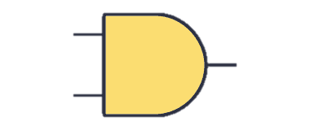
AND GATE
1
1
1
0
1
0
0
0
0
0
1
0

Slide 6
XOR GATE
INPUT A | INPUT B | OUTPUT
1 | 1 | 0
1 | 0 | 1
0 | 1 | 1
0 | 0 | 0

Slide 7
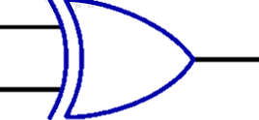
XOR GATE
1
1
0
0
1
0
0
0
1
0
1
0

